Slide 1

Peer Instruction Xblock

Slide 2

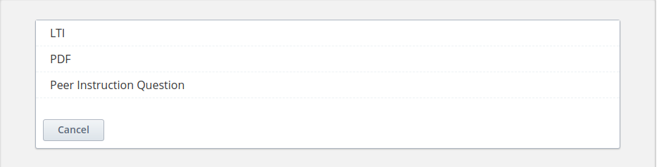
Studio
Unit:
Select Advanced Option:

Slide 3
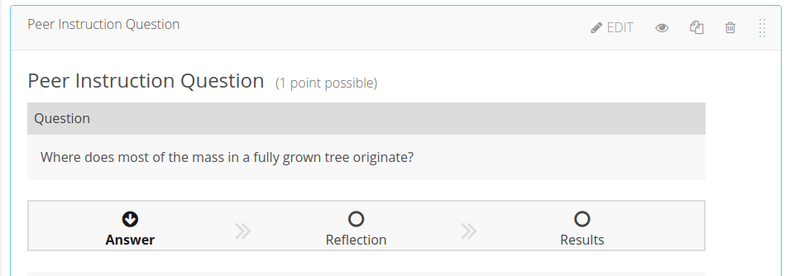
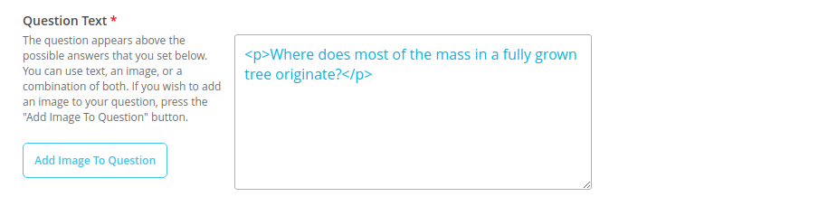
Select Peer Instruction Question :
Click On Edit and set Question Text:

Slide 4
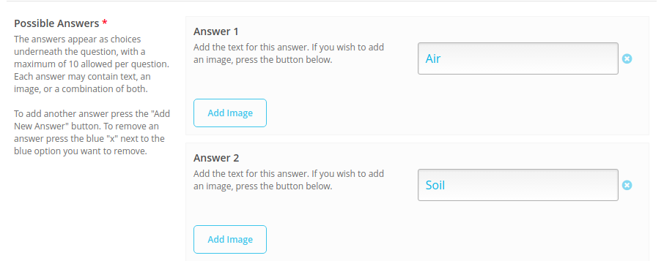
Set Possible Answers :
The answers appear as choices underneath the question, with a maximum of 10 allowed per question also add image.

Slide 5
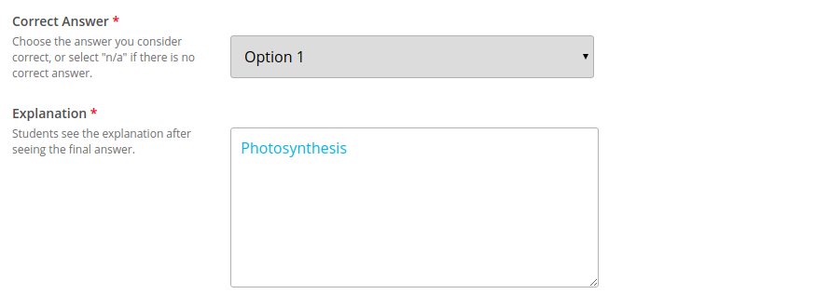
Correct Answer:
Choose the answer you consider correct, or select "n/a" if there is no correct answer.

Slide 6
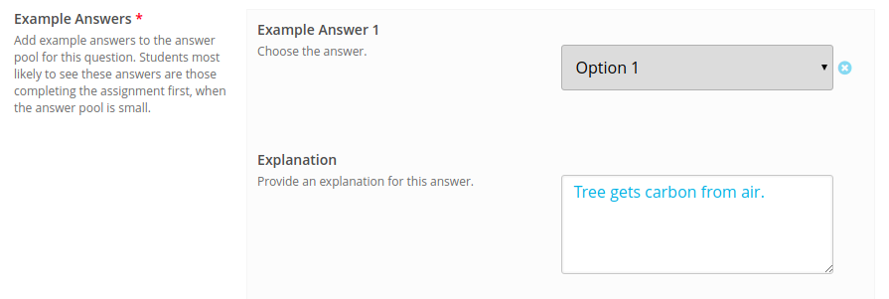
Example Answers:
Add example answers to the answer pool for this question. Students most likely to see these answers are those completing the assignment first, when the answer pool is small.

Slide 7
Answers Students See - Selection Logic:
Simple :- Show all examples answer possibility if learner press next step in this problem.
Random :- Random display example answer if learner press next step in this problem.
Answers Students See - Number Selected:
This is the number of examples shown to the students after they answer.

Slide 8
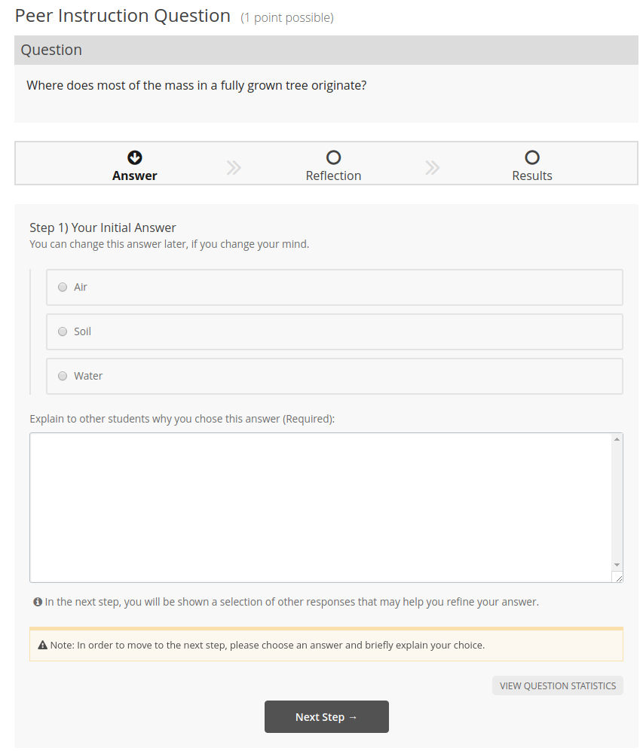

LMS

Slide 9
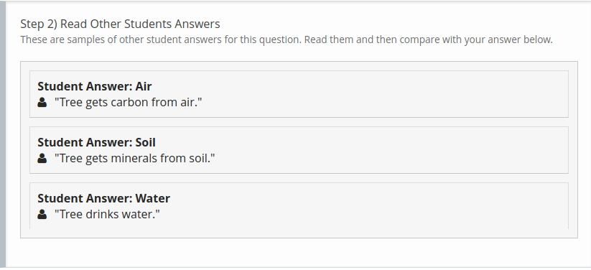
First ,Student Choose answer and give explanation for it then move to the click next step button.
Example: If We select Water option and give its explanation so next step suggest different answers.

Slide 10
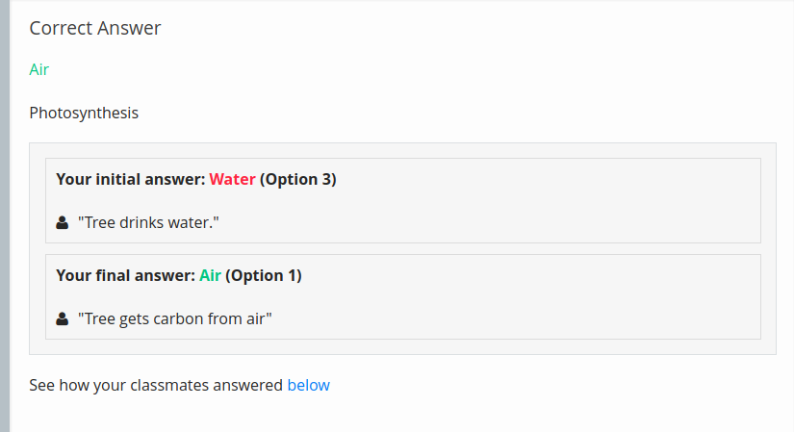
Select Final answer based on suggestion and give its explanation and move towards next step.
Example : If we change our answer Air based on suggestion and change explanation so result will be given below.

Slide 11
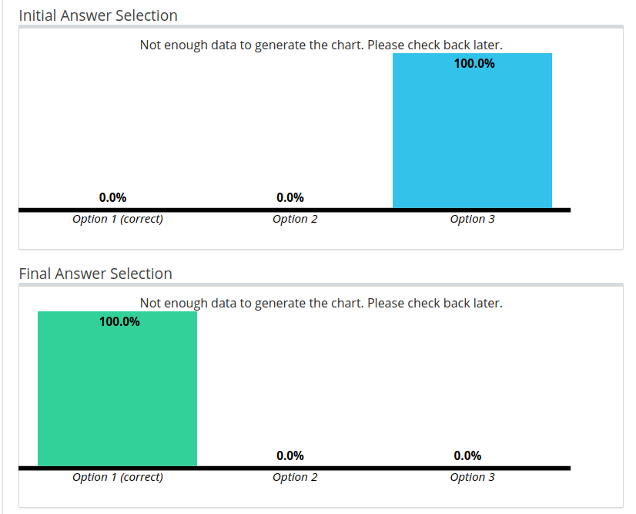
Graph:

Slide 12


